Slide 1
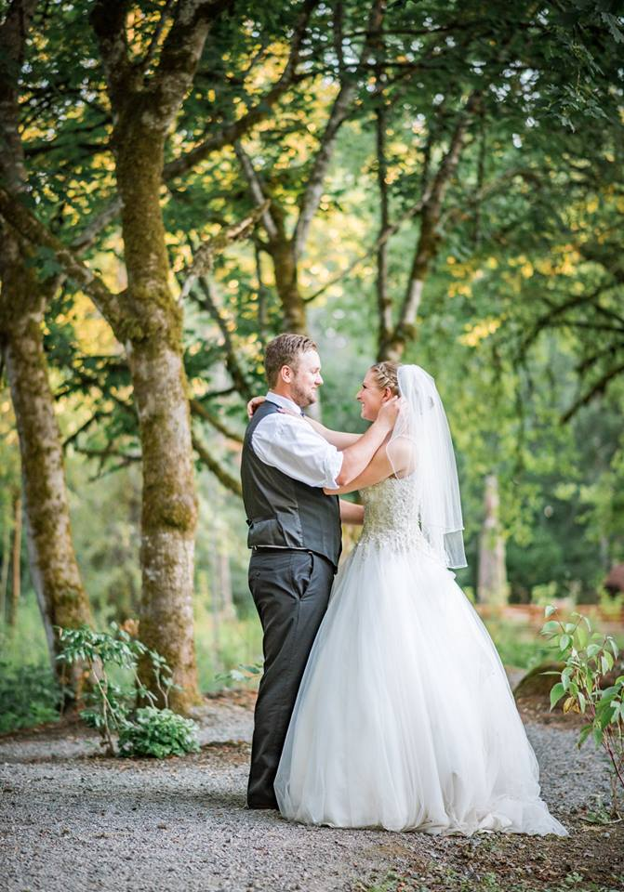
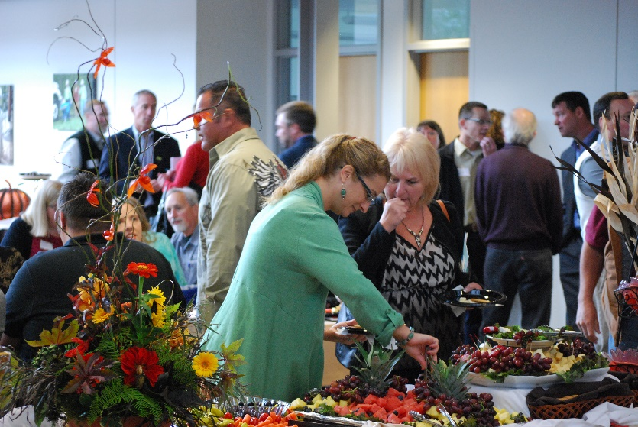
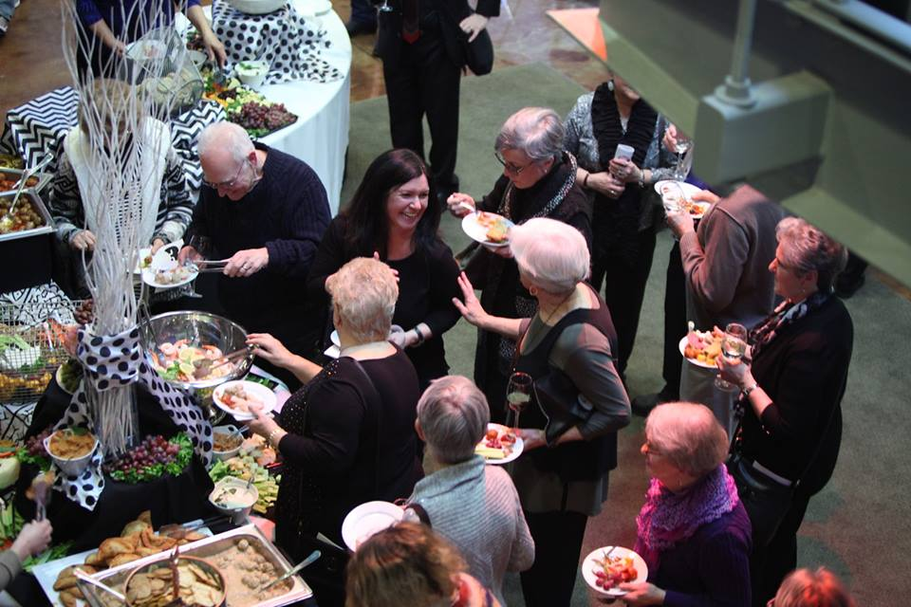
Events & Conference Services
Notes:
Updated 8-18-15, 2015

Slide 2
What Have We Been Up To?
Created single/multi-campus forms for:
External Reservation Requests
Facility Use Agreement
Sponsorship Request Form
Hosted Event Request Form
Updated our Facility Use Fees

Slide 3
What Have We Been Up To?
Created consistent processes for all campuses for different event types
Created an online invoicing and payment option for our external customers
Updated our outfacing website
www.Clackamas.edu/event-services
Created brochure to market our facilities

Slide 4
Let’s Chat About…
Facility Use Fees
Defining Event Types
Processes for Each Event Type
Forms
Announcements/FYI

Slide 5
Facility Use Fees
Three Fee Schedules
Nonprofit/Government/Individual Entities
For Profit Entities
Commercial Film and Photography

Slide 6
Event Types
Internal
Sponsored
Hosted
External
What does this mean?
Definitions & Criteria for each Event Type

Slide 7
Event Types
Internal – No approval needed
Sponsored – Approved by Dean or higher level
Hosted – Approved by VP or College President
External – Approved by ECS
What’s the Process for Each Event Type?

Slide 8
Forms
All three campuses now have the same forms
Sponsorship Request Form
Hosted Event Request Form
Reservation Request Form
Facility Use Agreement
Find all forms, and this presentation, at:
F:\Temporary\Events and Conference Svs

Slide 9
FYI & Announcements
All three ECS offices now have one email:
Events@Clackamas.edu
Spaces at OC and Harmony campuses requiring a special setup, must be requested for the entire day.
Examples include Gregory Forum, Board Room, ITC-203-AB, Harmony Community Room, etc.
All event-related requests such as media and setup must be requested through 25Live

Slide 10
FYI & Announcements
Employees receive a -50% discount on facility rentals for their personal, external events.
Dedicated videoconferencing rooms:
ELC Lakeside Hall
McLoughlin 226
RR117
Barlow 204 and 240
Community Center 126
Harmony Conference Room
Wilsonville 207 (no computer-check out laptop)
*Videoconference Trainings TBD in January*

Slide 11
More to Come!
Updating alcohol policies and guidelines
Updating Facility Use and Terms AR
Continuing work on policy updates
Continue work to create cohesive processes across multiple campuses
*We will be repeating this presentation this week at President’s Council and College Council*

